Slide 1
Node.js
IT 328
Tina Ostrander

Slide 2


Slide 3
What is Node.js?
An environment for using JavaScript outside of a web browser
Web server
Desktop
Provides networking, file I/O, database access
Used for building data-intensive real-time applications
Unifies language and data format
Built on V8

Slide 4
About V8
Google's JavaScript runtime engine for Chrome
Open source
Written in C++ (fast!)
Translates JavaScript to machine code and caches it (fast!)
Uses compiled code (fast!)
Handles garbage collection efficiently (fast!)
Notes:
Node is not interpreted which makes it faster and not loosely typed, which makes it less error prone

Slide 5
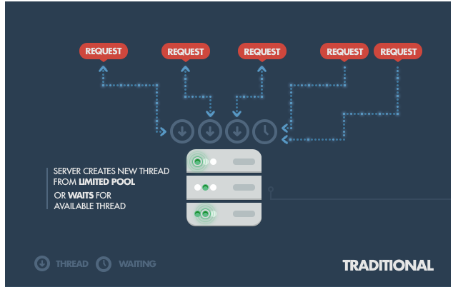
Traditional Model
Notes:
Each request spawns a new thread, taking up server RAM and eventually maxing out RAM available

Slide 6
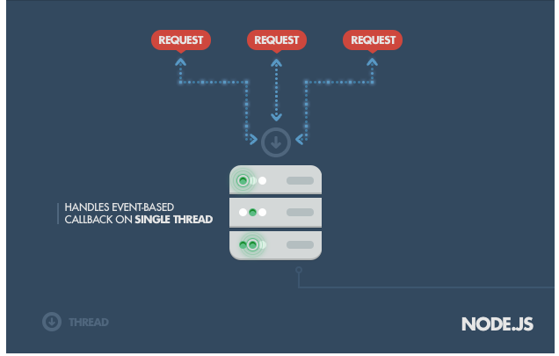
Node.js Model
Notes:
Node.js operates on a single thread, using non-blocking I/O calls
Can support tens of thousands of simultaneous connections
Not good for heavy computations, which can choke the single thread

Slide 7
Where Node Should Be Used
Real-time, multi-user, lightweight, data-intensive apps
Low processing/computation
Examples
Chat
Data Streaming
Stockbroker trading software
Application or system monitoring (see Hummingbird)
See a list of companies and projects using Node
Notes:
Hummingbird, which tracks website visitors and visualizes their interactions

Slide 8
Where Node Should Not Be Used
When you need access to a relational database
Heavy server-side computation/processing

Slide 9
The Node.js Framework
The node command launches a JavaScript engine
The Node Package Manager (NPM) contains useful modules
A core library API interfaces to the OS and the network

Slide 10
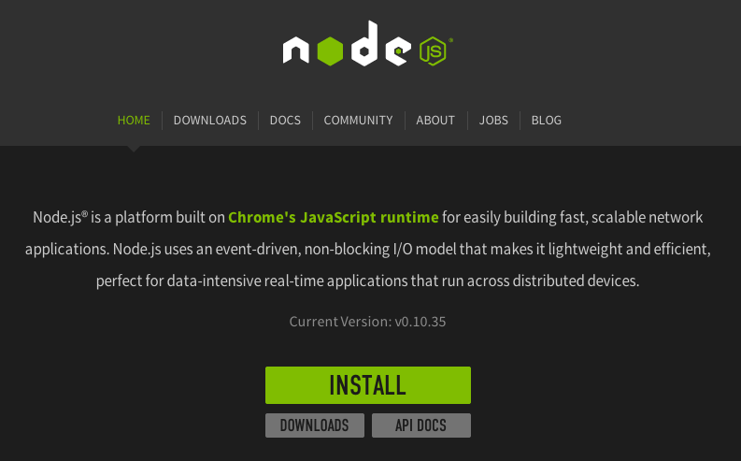
Getting Node.js on your local machine
Visit nodejs.org
For Windows and OS X
INSTALL button
For Linux
Use a package manager
Run as root

Slide 11
Where Is It?
Windows
\Program Files\nodejs
OS X and Linux
/usr/local/bin

Slide 12
Running on a VM
We will install and run Node.js on a virtual machine – the guest
Our local computer – the host – will run the vm

Slide 13
Running Node on AWS
Create an AWS account
Create a server instance
Connect to your instance
Installing Git and Node.js
Stopping and starting your instance
Upload files to your AWS server
Configure security on your AWS server

Slide 14
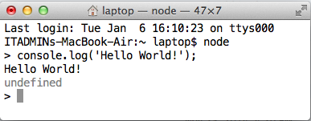
Hello World I
Open a terminal window
On Mac: Terminal
On a P.C.: Start → cmd
If you're on AWS, connect to the server
node command launches the read-execute-print-loop (REPL)
Execute a statement and display the result
Use ctrl + d to exit the REPL
console.log returns undefined

Slide 15
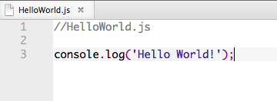
Hello World II
Given a filename, node executes the script
Make sure you're in the directory that contains the script
$ node HelloWorld.js
Hello World!

Slide 16
Node Packages and Modules
Node comes with a core set of packages
Packages contain modules
Packages are installed
Programs use a module
File System I/O
File System
Path
Fundamentals
Globals
STDIO
Timers
Events
Streams
Buffers
Network I/O
HTTP
HTTPS
URL
Query Strings
Net
DNS
Misc
Crypto
TLS/SSL
String Decoder
ZLIB
OS
Testing/Debugging
Assertion Testing
Debugger
Utilities

Slide 17
The Node Package Manager (NPM)
Used to install packages
Packages are loaded from http://npmjs.org
npm install <package>[@version] [-g] [--save]
Packages installed globally are used across projects
Packages installed locally are part of a particular project

Slide 18
A Few Popular NPM Modules
Express - Used for developing web applications
Connect - A foundation for Express
Jade - A templating engine used in Express
Mongo – Used to interface with MongoDB databases
Underscore – A utility library

Slide 19
Ready, Set, Go
Create a directory called flightProject
Change to the project1 flightProject
$ mkdir flightProject
$ cd flightProject

Slide 20
Installing Modules
gulp is an automation tool used across projects, so we will install it globally
node-uuid is used to generate unique IDs, and it will be used locally
run as admin
$ sudo npm install gulp –g
$ npm config get prefix
$ npm install node-uuid
$ npm update node-uuid
$ npm uninstall node-uuid
location of global packages bin directory

Slide 21
package.json
package.json is a json file that defines a project
can be shipped with the project
modules can be installed on the other end
must be created manually
local packages are defined in "dependencies"
{
"name": "Flights",
"version": "0.1.0",
"dependencies": {
"node-uuid": "^1.4.1"
}
}
this is a json object

Slide 22
package.json
name and version properties are mandatory
version must be valid semver (semantic versioning)
major.minor.patch
Module versions may be referenced as:
"*" load the latest version
"major.minor.version" load this exact version
">major.minor.version" load at least this version
Maintain package.json dependencies with npm
npm install node-uuid --save
npm install gulp --save-dev
node will add the dependencies to the package.json file

Slide 23
Steps to Follow
Create a new project folder
Create a package.json file in the project folder
Add dependencies to package.json file
Run npm install to install all packages
When you add new packages, install with --save so they will be added to package.json
Ship the project with the file, but without the packages

Slide 24
Try It
From your flightProject directory, create a package.json file:
From the prompt, type npm install. This will create a node_modules directory containing node_uuid.
{
"name": "Flights",
"version": "0.1.0",
"dependencies": {
"node-uuid": "^1.4.1"
}
}

Slide 25
Using a Module
once a module is installed, it needs to be loaded
require is used to load modules
Create this file
Execute with
$ node flightData
3. Modify the script to print the other flight data
// flightProject/flightData.js
var uuid = require('node-uuid');
// Define a flight object
var flight = { flight: 1435, orig: 'ORD', dest: 'SFO', km: 2960, price: 133.00 };
// Get a flight ID
flight._id = uuid.v1();
console.log ('ID: ' + flight._id);

Slide 26


Web Servers
In a traditional model, a web server (e.g. Apache) communicates with the web application (e.g. PHP)
In Node.js, the web application contains the web server
The server is an object that listens for URL requests and maps a request to a function.
Node
static files
server object
database
function

Slide 27
HTTP Module
Mode's http module is part of the core distribution, and doesn't need to be installed
We will use HTTP to create a server
Our HTTP server will deliver the client-side part of the application
HTML
CSS
JavaScript

Slide 28
Creating a node server
Require the HTTP module
Create the server object and a callback function
Listen for HTTP requests
This imports the http module and stores it in an http variable
// server.js
var http = require('http');
function requestHandler(req, res) {
//code
}
var server = http.createServer(requestHandler);
server.listen(8080);
This is the only thing the server does
The request object is an event
The response object contains methods for processing the response

Slide 29
Creating a response
res.writeHead (status[, description][, headers])
defines HTTP protocol headers
res.write(data[, encoding])
renders content
res.end([data] [,encoding]);
sends the response and, optionally, the last piece of data

Slide 30
Creating a response
// server.js
var http = require('http');
function requestHandler(req, res) {
res.writeHead(200, 'OK', { 'Content-Type': 'text/html' });
res.write('<html><body><h1>Hello world</h1>');
res.end('</body></html>');
}
var server = http.createServer(requestHandler);
server.listen(8080);
What is this?

Slide 31
Try it
Create server.js in the flightData directory
From a terminal window, navigate to the flightData directory
Type npm start at the command prompt to run the server
// server.js
var http = require('http');
function requestHandler(req, res) {
res.writeHead(200, 'OK', { 'Content-Type': 'text/html' });
res.write('<html><body><h1>Hello world</h1>');
res.end('</body></html>');
}
var server = http.createServer(requestHandler);
server.listen(8080);

Slide 32
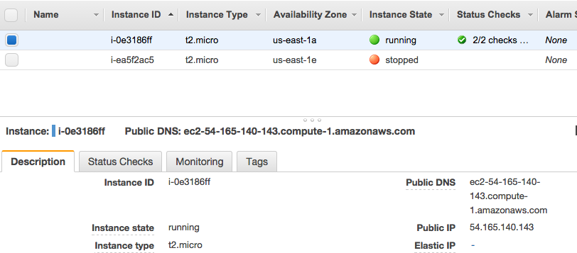
Try it
Navigate to your server in a web browser
http://localhost:8080 on the local machine
http://publicDNS:8080/ with your AWS server, where Public DNS is copied from the AWS console
Use Ctrl+c to stop the server
Note: You need to stop and restart your server every time you make a change.

